Slide 1
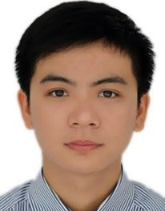
Suggesting Natural Method Names to Check Name Consistencies
Son Nguyen
Hung Phan
Trinh Le
Tien Nguyen

Slide 2
Programming with Libraries
getMaxValue
getMaximumTime
getHostName
getHostAddress
Devs often don’t look inside the body of the methods

Slide 3
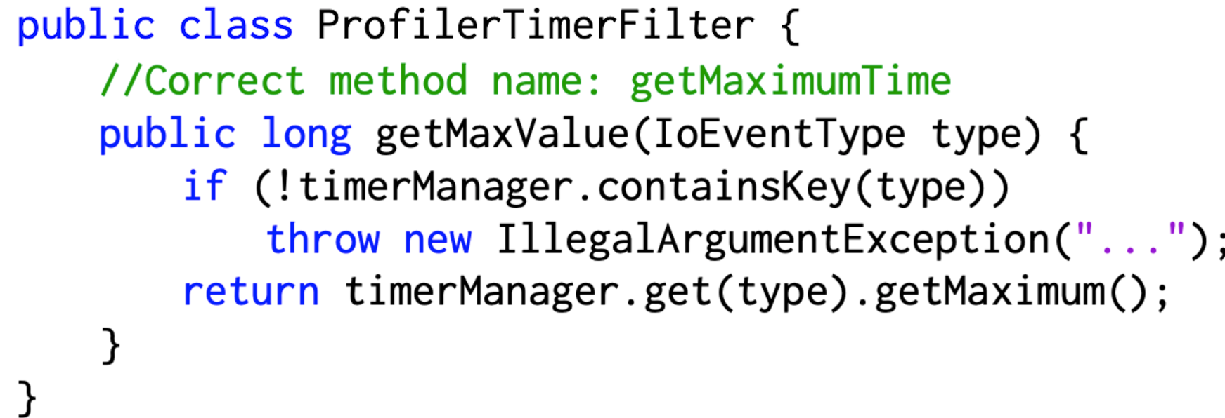
Method Name Inconsistency
Renamed public methods in ProfilertimerFilter to clarify its meaning
Apache MINA

Slide 4
Method Name Inconsistency
Confuse engineers on API usages, leading to misuses and defects
switch to IP everywhere
rename getHostName -> getHostAddress since it should always be an IP now
Apache Cassandra

Slide 5
MNire
I suggest: getMaximumTime
The alternative: getMaximumTime
Not similar. INCONSISTENT!
Are getMaximumTime and getMaxValue sufficiently similar?

Slide 6
Suggesting Natural Method Names
Naturalness of Names at Token Level
Abstractive Summarization

Slide 7
Suggesting Natural Method Names
????

Slide 8
Suggesting Natural Method Names
????
Implementation Context

Slide 9
Suggesting Natural Method Names
Interface Context
????

Slide 10
Suggesting Natural Method Names
Enclosing Context
????

Slide 11
Empirical Study
The empirical foundation on whether the contexts have impacts on predicting method names
14K top-ranked, high-quality, long-history Java projects
2M files and 17M methods

Slide 12
Uniqueness of Method Name
Cannot rely solely on searching for a good the previously seen method names
Do you know “getMaximumTime”?
62.9% of the full method names are unique
I’ve never seen this one in my life

Slide 13
Uniqueness of Method Name
78.1% of the tokens can be found in the other previously seen method names
.
Do you know “getMaximumTime”?
No. But I know
“get”, “Maximum”, and “Time”?

Slide 14
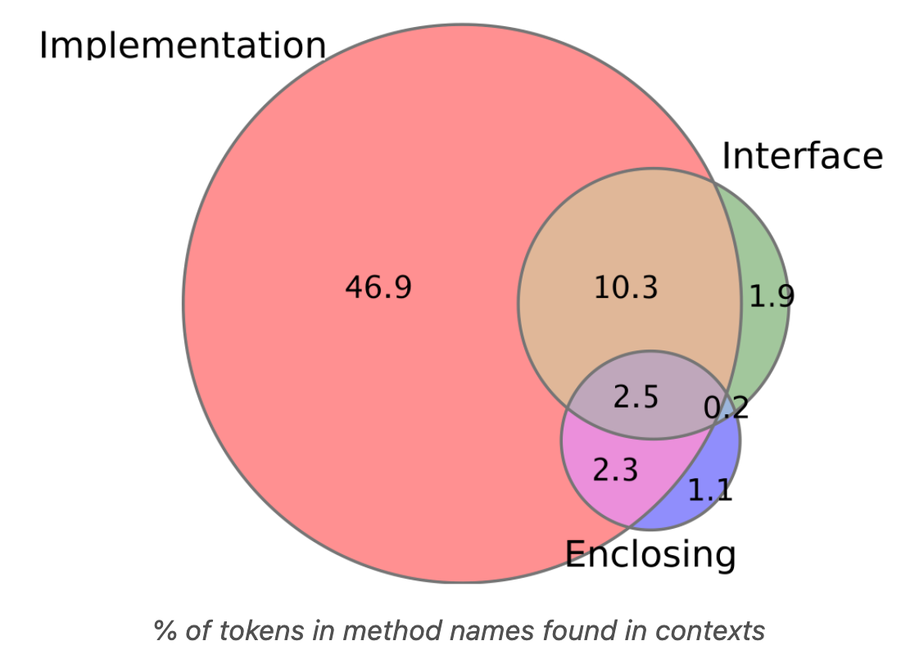
Tokens in method names and the contexts
65.0% of method names’ tokens which are shared with the three contexts

Slide 15
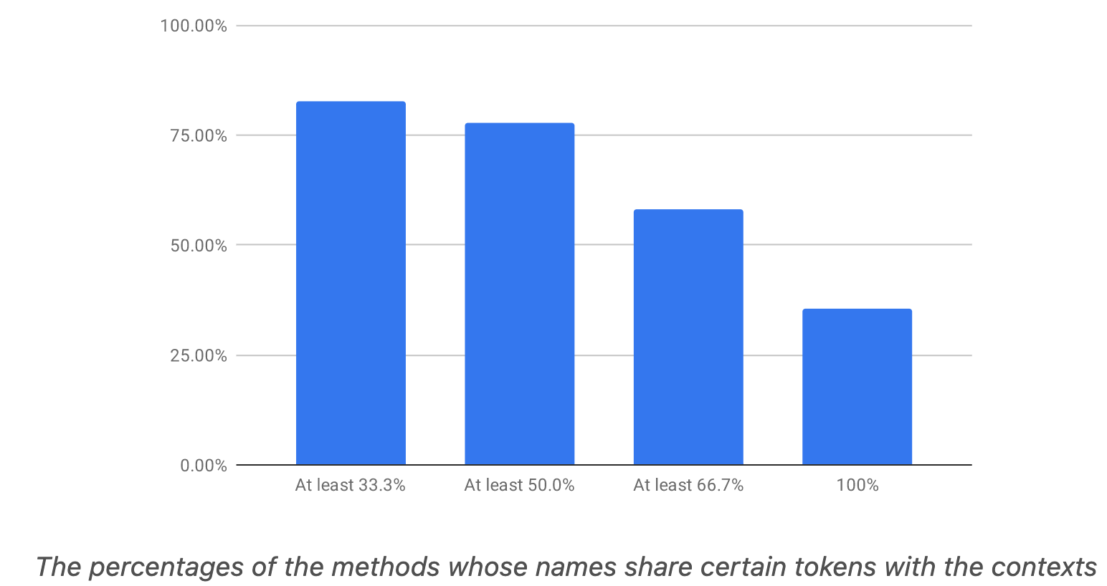
Tokens in method names and the contexts
79.8% of the methods whose tokens in their
names share +50% with the contexts’ tokens.

Slide 16
Tokens in method names and the contexts
For implementation context, in 35.9% of the cases, we could see a token in the method’s name
When I see you,
I always see your hat!
When encountering the tokens in the contexts,
How many times we could see a token in the method name?

Slide 17
Tokens in method names and the contexts
Even the tokens are not in the contexts,
they can be used to predict the method names’ tokens
When I see you,
I always see your hat!
When encountering the tokens in the contexts,
How many times we could see a token in the method name?
Notes:
Among the cases of P(t|C) = 1, the percentage of the cases in which the token t does not appear in C where C is implementation context is 43.6%

Slide 18
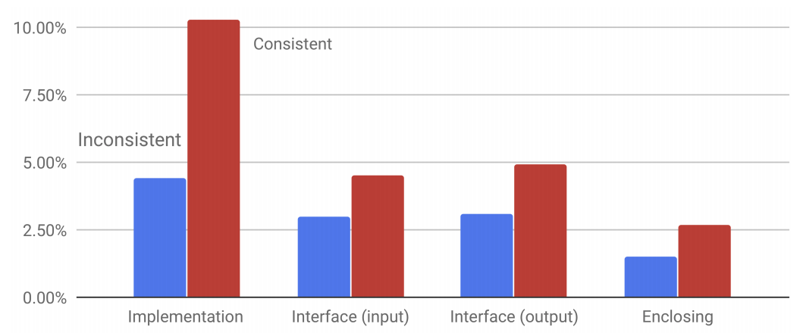
Tokens in method names and the contexts
The occurrences of the tokens in the good names more than in inconsistent names.
Notes:
Among the cases of P(t|C) = 1, the percentage of the cases in which the token t does not appear in C where C is implementation context is 43.6%

Slide 19
Suggesting Natural Method Names
Naturalness of Names at Token Level
Abstractive Summarization
Contexts

Slide 20
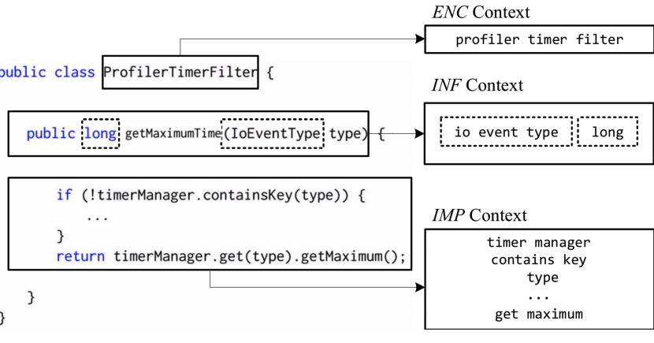
MNire: CONSISTENCY CHECKING MODEL
get maximum time
seq2seq
Sim(n,n’) < Threshold?
get maximum value
get maximum time

Slide 21
Empirical Methodology
Accuracy and Comparison
Context Analysis
Sensitivity Analysis
Usefulness
1
2
3
4

Slide 22
Datasets
 | Test data | Train data
#Methods | 2,700 | 1,962,872
#File | 30.2% | 250,972
#Projects |  | 430
#Unique method names |  | 540,237
#Occurence > 1 |  | 33.5%
Method Name Consistency Check

Slide 23
Datasets
Split the corpus based on the #projects
This dataset $≠$ the dataset in our empirical study
 | Test data | Train data
Dataset 1 – For comparison
#Files | 61,641 | 1,746,272
#Methods | 458,800 | 14,000,028
Dataset 2 – For others
#Project | 450 | 9,772
#Files | 51,631 | 1,756,282
#Methods | 466,800 | 13,992,028
Method Name Recommending

Slide 24
Metrics for Name Consistency Check
$$Precision=\frac{|TP|}{\left|TP\right|+|FP|}$$
IC
$$Recall=\frac{|TP|}{\left|TP\right|+|FN|}$$
$$Precision=\frac{|TN|}{\left|TN\right|+|FN|}$$
C
$$Recall=\frac{|TN|}{\left|TN\right|+|FP|}$$
$$Accuracy=\left|TP\right|+|TN|$$

Slide 25
Metrics for Name Recommendation
$$e−expected name, r −recommended name$$
$$Precision(e,r)=\frac{|token\left(e\right)∩token\left(r\right)|}{|token\left(r\right)|}$$
$$Recall(e,r)=\frac{|token\left(e\right)∩token\left(r\right)|}{|token\left(e\right)|}$$

Slide 26
Consistency Checking: Comparison
Recall and precision:
For IC, 10.4% and 10.8% relatively higher
For C, 16.6% and 9% relatively higher
 |  | Liu et al. | MNire
IC | Precision | 56.8 | 62.7
 | Recall | 84.5 | 93.6
 | F-score | 67.9 | 75.1
C | Precision | 51.4 | 56.0
 | Recall | 72.2 | 84.2
 | F-score | 60.0 | 67.3
Accuracy |  | 60.9 | 68.9

Slide 27
Consistency Checking: Comparison
MNire achieves relatively higher than code2vec in both recall (18.2%) and precision (11.1%)
 | code2vec | MNire
Precision | 63.1 | 70.1
Recall | 54.4 | 64.3
F-score | 58.4 | 67.1
Exact match | --- | 43.1

Slide 28
Consistency Checking: Comparison
43.1% of the suggested cases are exactly matched
 | code2vec | MNire
Precision | 63.1 | 70.1
Recall | 54.4 | 64.3
F-score | 58.4 | 67.1
Exact match | --- | 43.1

Slide 29
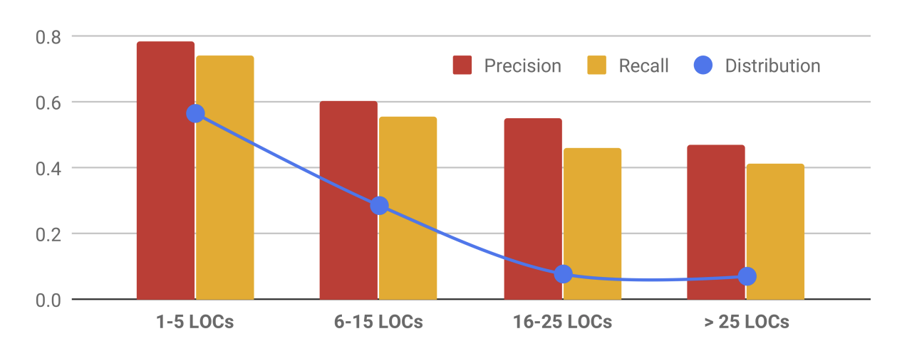
Accuracy by different Methods’ Sizes
It is harder to capture
the functionality of a longer method

Slide 30
Consistency Checking: Context Analysis
 |  | IMP | IMPL+INF | IMP+ENC | MNire
IC | Precision | 60.2 | 61.7 | 61.0 | 62.7
 | Recall | 90.0 | 92.1 | 91.3 | 93.6
 | F-score | 72.1 | 73.9 | 73.1 | 75.1
C | Precision | 53.2 | 55.1 | 54.1 | 56.0
 | Recall | 79.3 | 82.3 | 80.6 | 84.2
 | F-score | 63.7 | 66.0 | 64.7 | 67.3
Accuracy |  | 62.1 | 65.2 | 64.2 | 68.9

Slide 31
Method Name Recommending: Context Analysis
 | IMP | IMPL+INF | IMP+ENC | MNire
Precision | 49.7 | 63.2 | 54.4 | 66.4
Recall | 43.3 | 57.8 | 48.9 | 61.1
F-score | 46.3 | 60.4 | 51.5 | 63.6
Exact match | 20.2 | 34.7 | 25.7 | 43.1

Slide 32
Consistency Checking Accuracy with Different Representations
 |  | Lexeme | AST | Graph | MNire
IC | Precision | 59.0 | 57.2 | 55.3 | 62.7
 | Recall | 88.3 | 85.6 | 50.3 | 93.6
 | F-score | 70.7 | 68.6 | 65.5 | 75.1
C | Precision | 47.1 | 46.2 | 45.8 | 56.0
 | Recall | 78.2 | 73.5 | 72.1 | 84.2
 | F-score | 58.8 | 56.8 | 56.0 | 67.3
Accuracy |  | 52.0 | 51.1 | 50.5 | 68.9

Slide 33
Method Name Recommendation Accuracy with Different Representations
The naturalness factor is more deciding factors
 | Lexeme | AST | Graph | MNire
Precision | 29.5 | 23.1 | 16.2 | 50.6
Recall | 25.1 | 29.2 | 30.3 | 45.1
F-score | 27.1 | 25.9 | 21.1 | 47.7
Exact match | 9.1 | 8.1 | 4.7 | 22.1

Slide 34
Method Name Recommendation Contexts’ Sizes
Using training data with longer contexts is better
 | 1–10 tokens | 10–20 tokens | 20–30 tokens | +30 tokens
F-score | 35.9 | 41.1 | 43.2 | 51.0

Slide 35
Method Name Recommendation Tokens’ Lengths in Contexts for Training
The methods with more tokens of the names having more than one character are better
 | 0–80% | 80–90% | 90–95% | +95%
F-score | 37.0 | 39.4 | 42.5 | 48.5

Slide 36
Method Name Recommendation Accuracy with Different Training Data
#Projects | 1.0K | 2.5K | 5.0K | 7.5K | 10K
Precision | 41.1 | 56.2 | 53.1 | 64.9 | 66.4
Recall | 47.8 | 53.7 | 57.6 | 59.5 | 61.1
F-score | 44.2 | 54.9 | 60.2 | 62.0 | 63.6
Exact match | 19.9 | 29.4 | 34.8 | 36.9 | 38.2

Slide 37
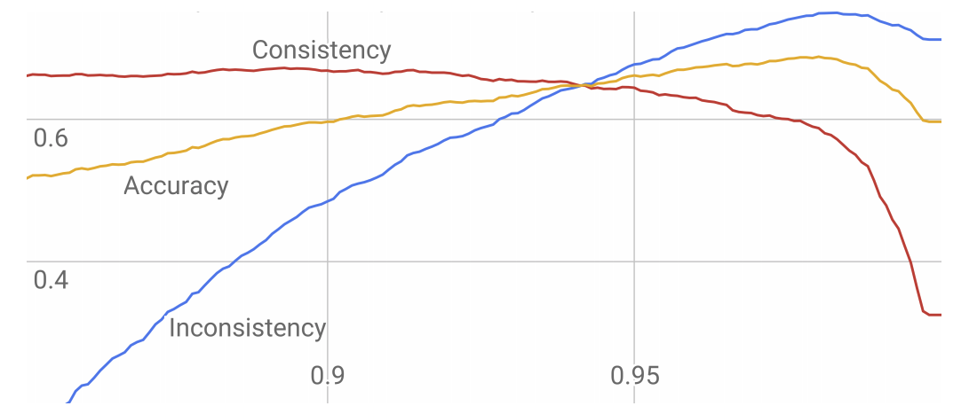
Method Name Consistency Check Threshold
0.94

Slide 38
Live Study on Real Developers
31/42 cases, the devs agree that our suggested names are more meaningful than the current names
Agree |  | Agree – but not Fix |  | Disagree | No answer | Total
Merged | Approved | Cannot Fix | Not Fix
5 | 13 | 5 | 8 | 11 | 8 | 50

Slide 39
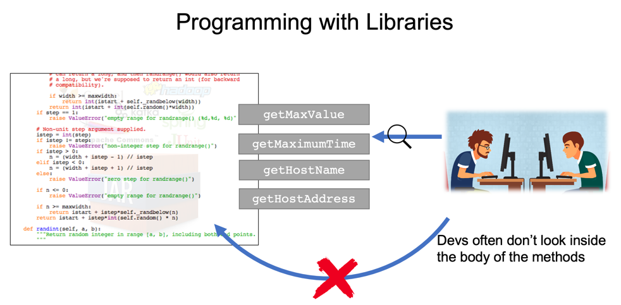
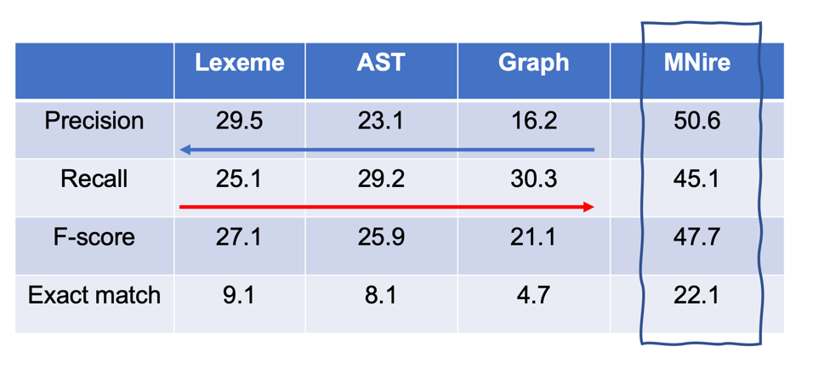
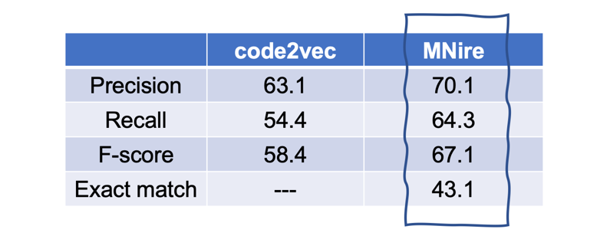
MNire

